Slide 1
Data Science in Business: Introduction to Machine Learning in Python
Dr. Peter Molnar
Sarah Zeis
Carly Wieting

Slide 2
Course Overview
Class 1: Introduction to Machine Learning and Set-Up Python
Class 2: Data Exploration
Class 3: Machine Learning Models (Decision Tree and KNN)
Class 4: Analyze Celebrity Tweets
Class 5: Forecasting with Facebook Prophet

Slide 3
Goals and Takeaways
Introduce business analytics and data science concepts
Introduce data types and learning types
Ensure students are set up with Python and can begin to code

Slide 4
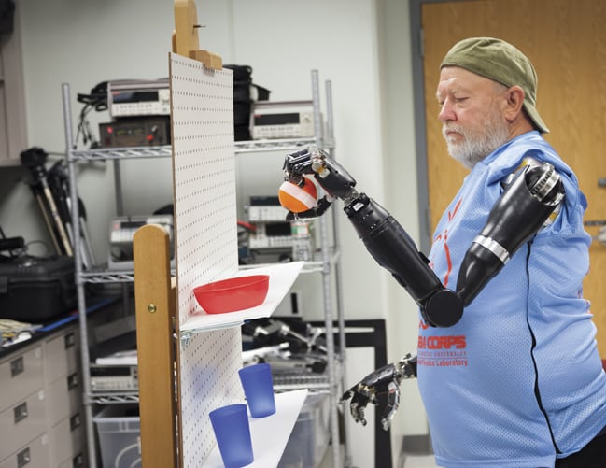
Artificial Intelligence
Artificial Intelligence (AI) is an area of computer science that creates intelligent machines that work like humans.
Examples:
Self driving cars
Robotics
Machine learning
Text, image, and speech analysis

Slide 5
What is Machine Learning?
“[Machine Learning is the] field of study that gives computers the ability to learn without being explicitly programmed.”
--Arthur Samuel, 1959
“A computer program is said to learn from experience E with respect to some task T and some performance measure P, if its performance on T, as measured by P, improves with experience E.”
--Tom Mitchell, 1997

Slide 6
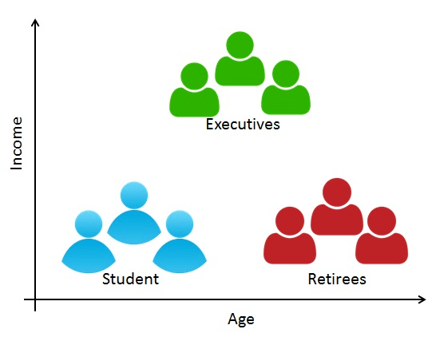
Data Science in Business Example
Customer Segmentation
Affects marketing and sales decisions
Customers are grouped together and then targeted for sales promotions, discounts, coupons, etc
Target your “buy now” customers versus your “get the best deal” customers
Notes:
https://www.datacamp.com/community/tutorials/introduction-customer-segmentation-python

Slide 7
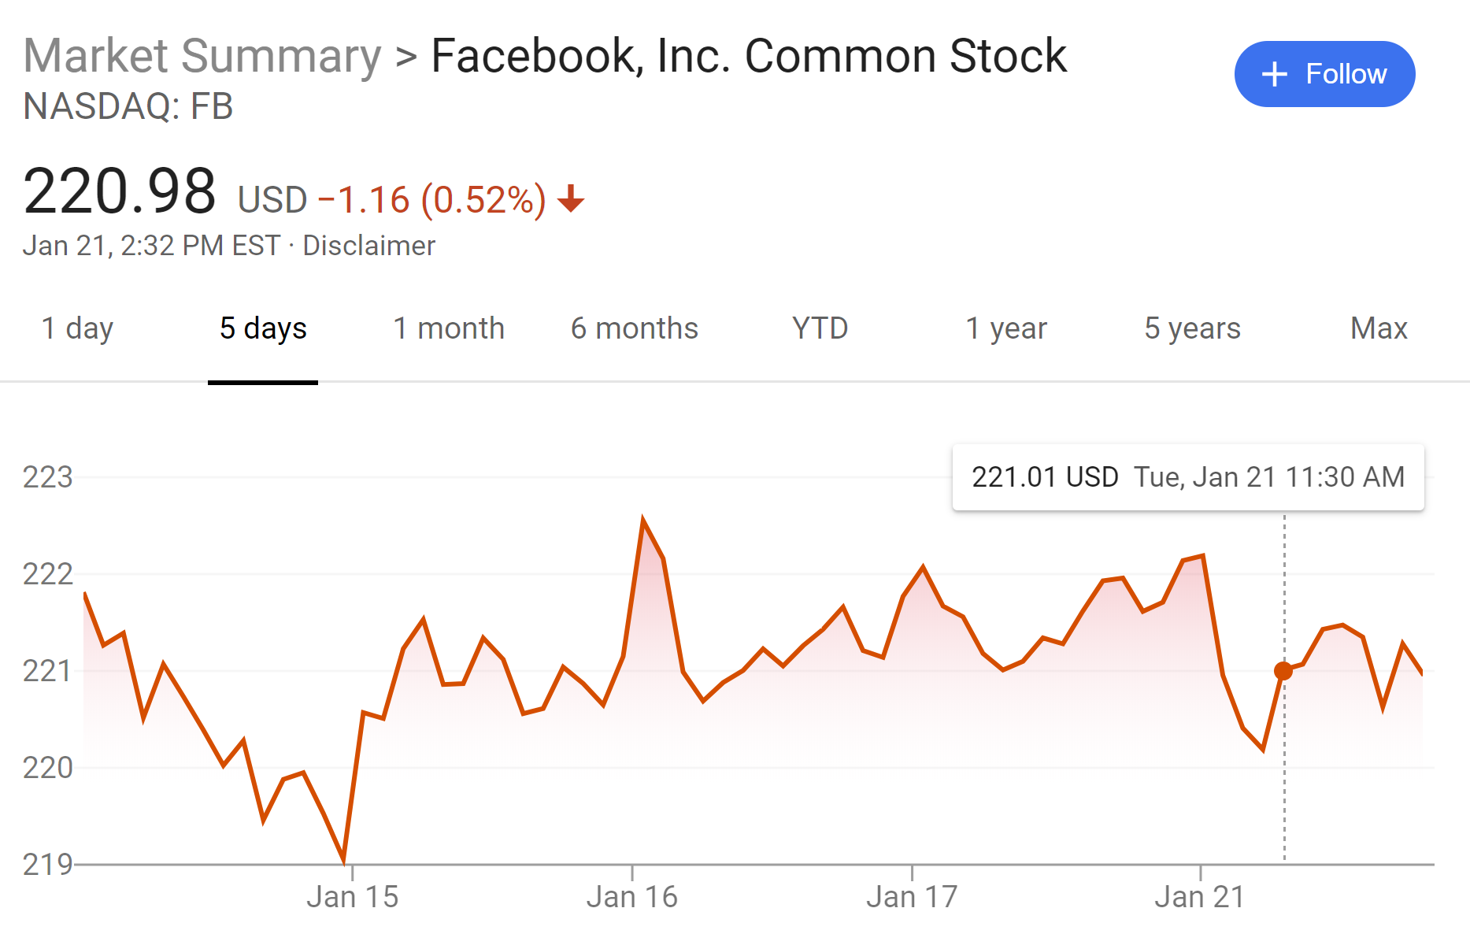
Data Science in Business Example
Forecasting Prices
Stockholders want to know what the market will look like in the future to maximize their profit.
They may forecast competitor pricing to make decisions for their own selling price.
Companies want to predict yearly/monthly sales for budget planning or decision strategy.
Notes:
https://www.datacamp.com/community/tutorials/introduction-customer-segmentation-python

Slide 8
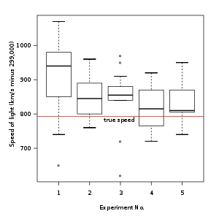
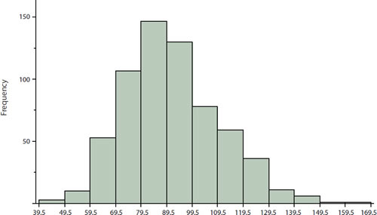
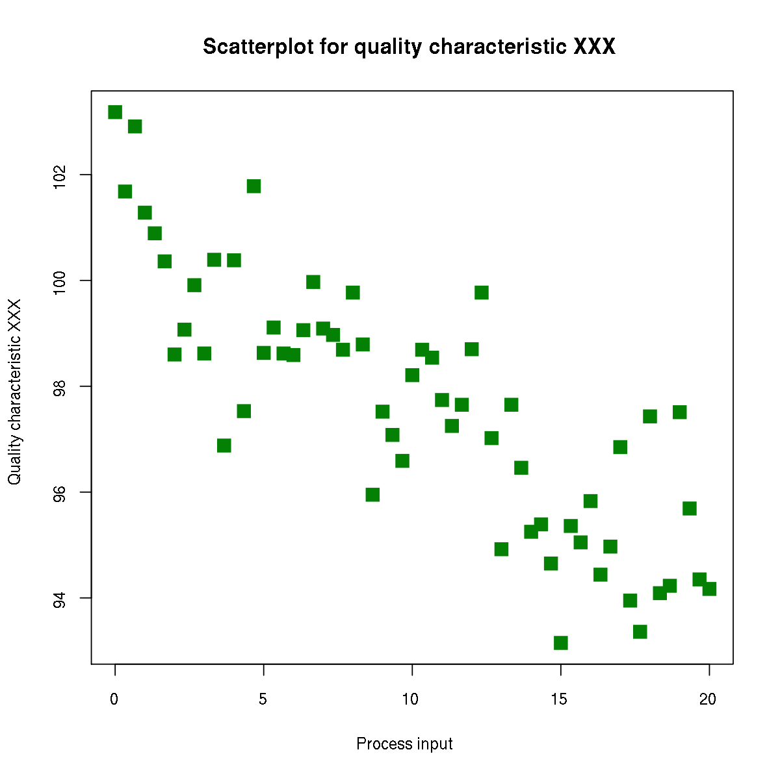
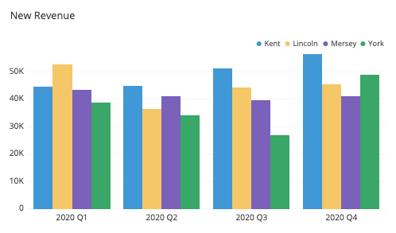
Graphical Analysis
Univariate analysis
Box plot, histogram, etc
Mean, median, mode, skewness, etc
Multivariate analysis
Scatter plots, bar charts, heat maps, pivot tables, etc
Correlation, analysis of variance, distributions

Slide 9
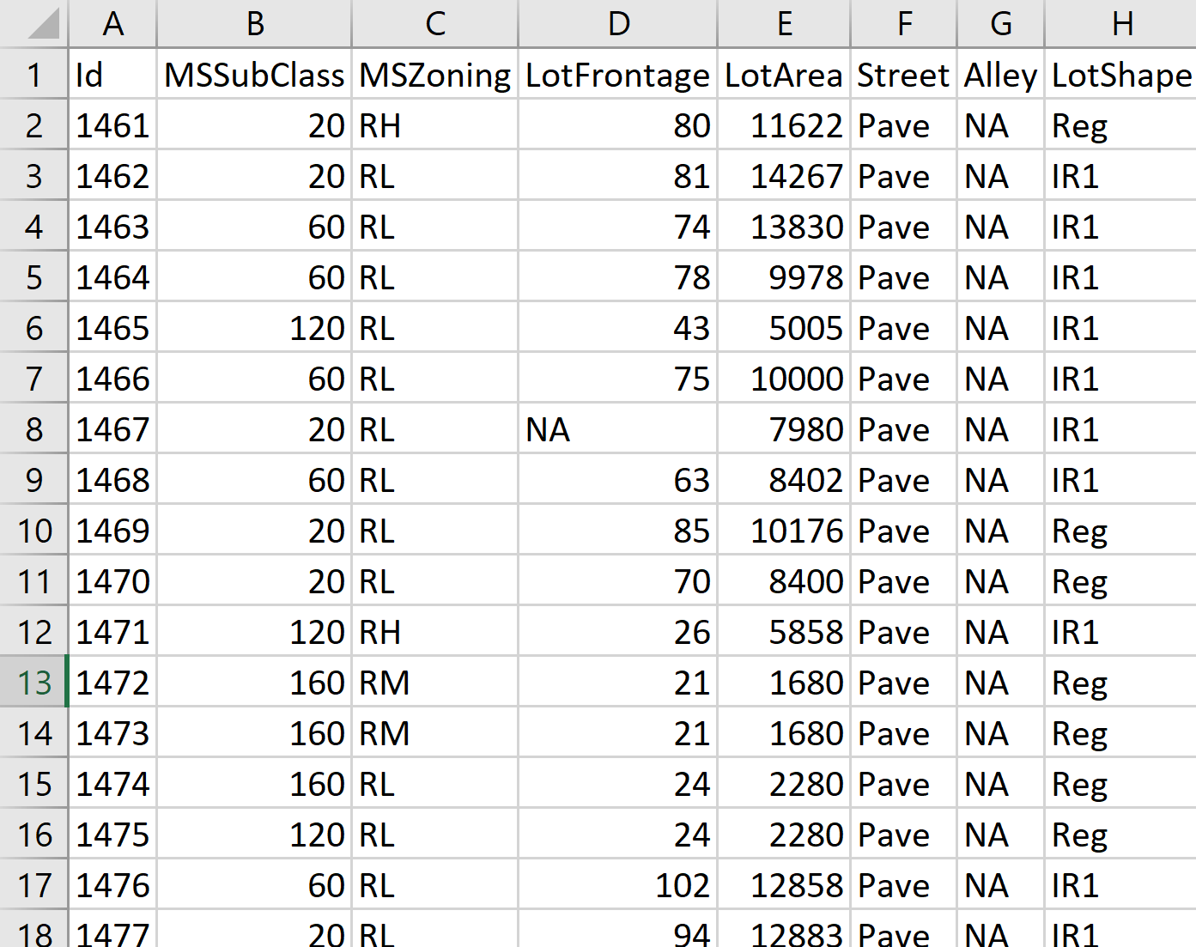
Structured Data
Structured data is in tabular form (spreadsheets)
Numerical and categorical data
Examples:
Square footage of a house
Room type
Is there a garage? (yes/no)
Address
Phone number

Slide 10
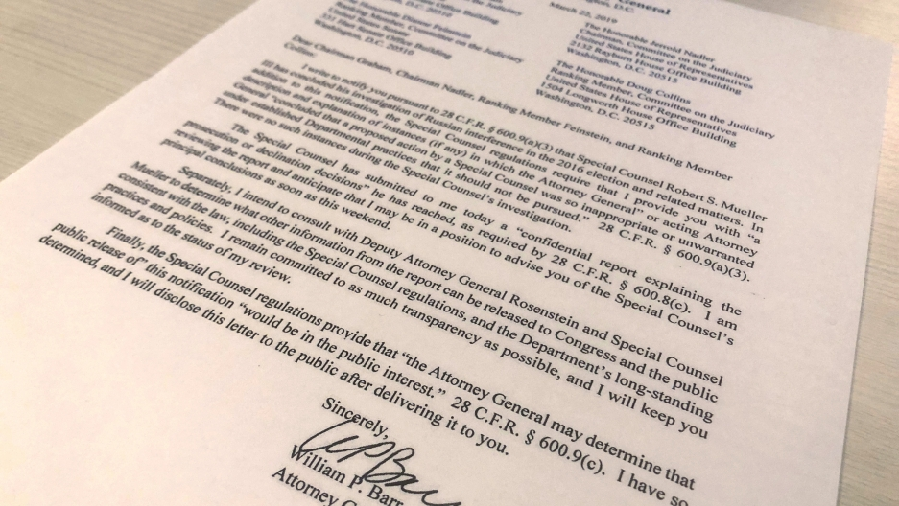

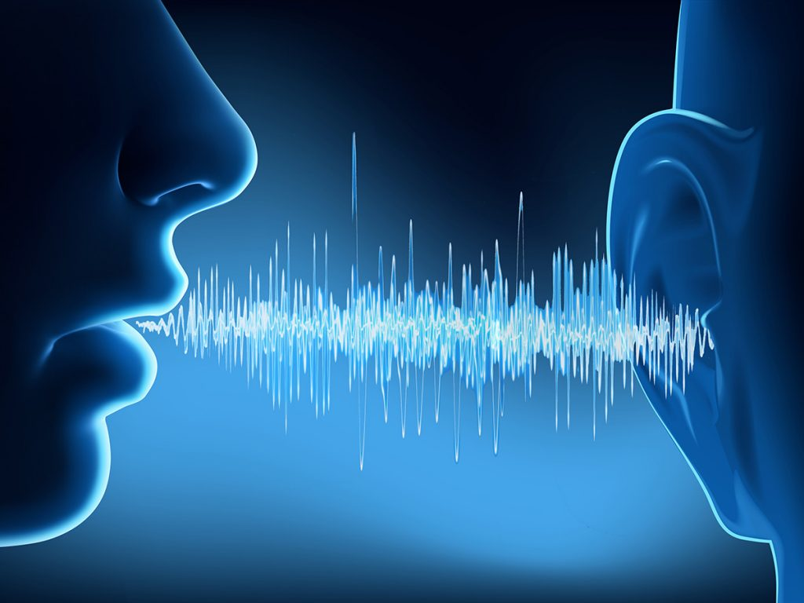
Unstructured Data
Includes text documents, images, and speech
How to analyze customer service phone calls
SEC filing trends (climate change)
Face detection
License plate recognition

Slide 11
Structured or Unstructured?
Using cameras on autonomous vehicles
Identifying market trends using stock prices and unemployment data
Facial recognition
Email spam filter
Use frequency of purchase, location, and time to segment customers
Predict house price based on location, size, and amenities

Slide 12
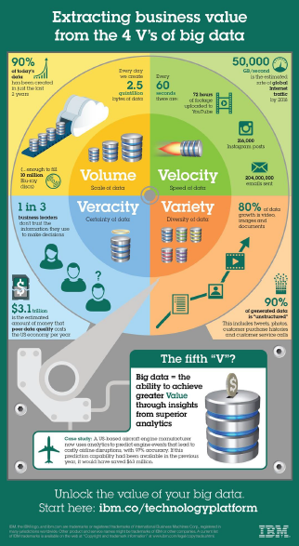
The Four V’s of Big Data
Volume – how much data is there?
Velocity – Speed of data
Veracity – Certainty of data
Variety – diversity of data
Value
What is Big Data?
Facebook has 2.1 billions monthly active users.
Every 60 seconds, 510,000 comments are posted, 293,000 statuses are posted, and 136,000 pictures are posted.
Amazon has 183,000,000 site visits per month.

Slide 13
Types of Learning
Supervised Learning
--Given a training set with outputs (labels)
Unsupervised Learning
--Given a training set, no outputs
Semi-supervised Learning
--Given a training set with some labels
Reinforcement Learning
--Rewards from sequence of actions
--Not used much in data science

Slide 14
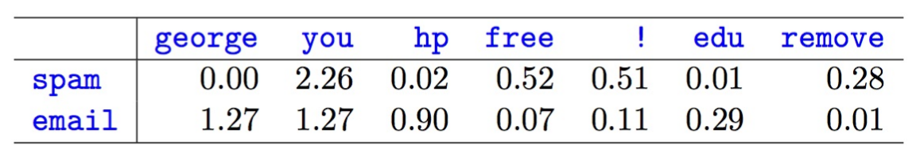
Supervised Classification
All incoming mail
Typical example is email spam filter
Classifies mail into two categories: spam and not spam
Words such as “gift card”, “free”, etc give the email a probability score
FILTER
Inbox
Spam

Slide 15
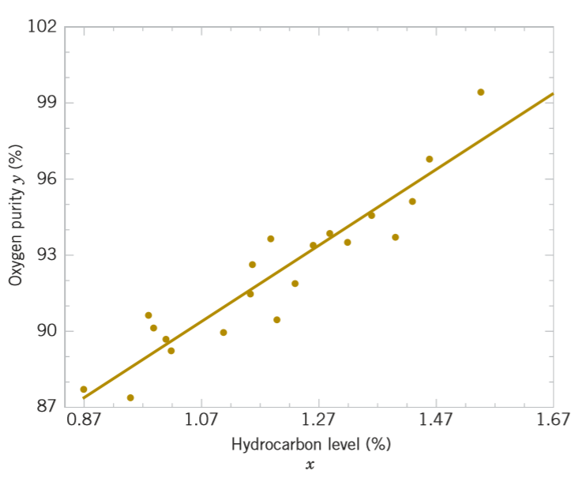
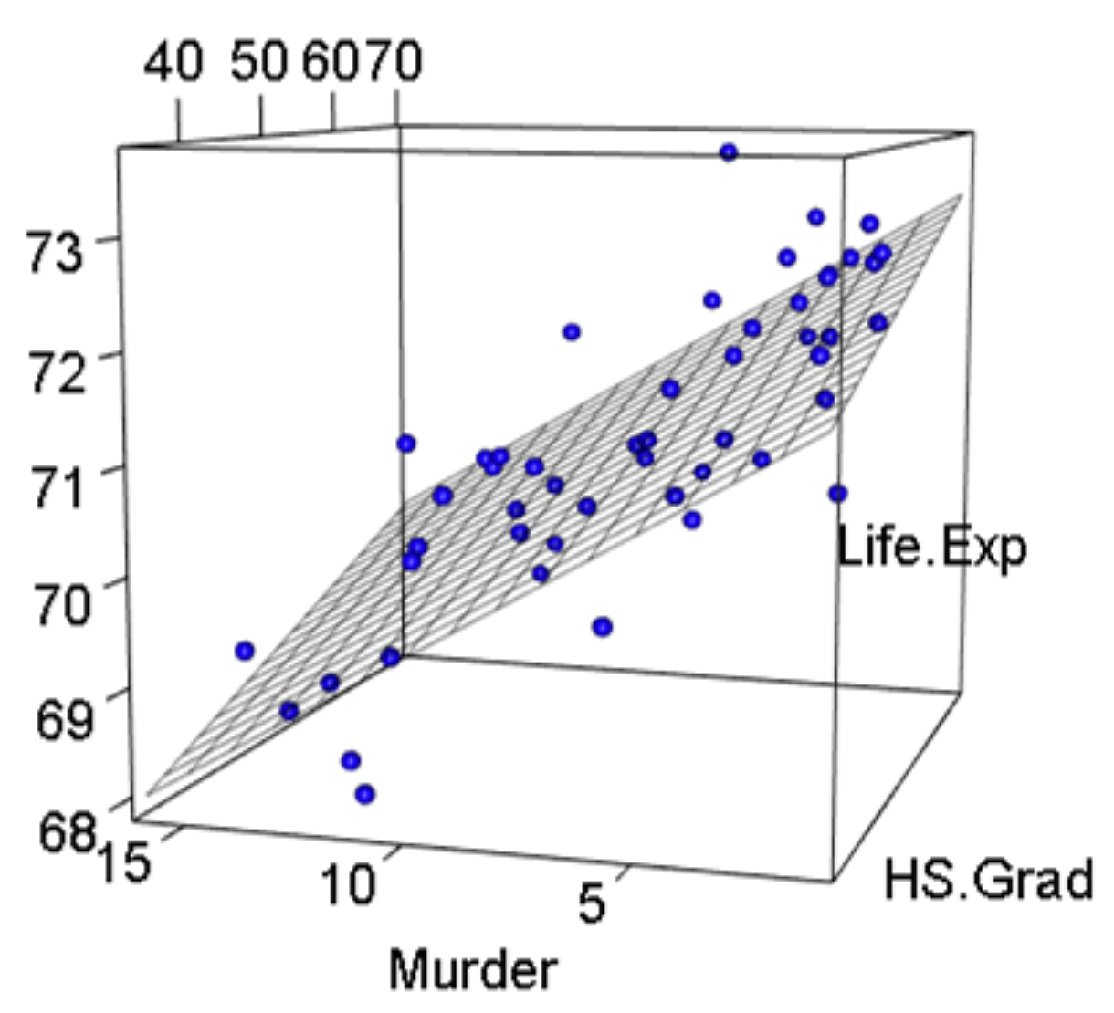
Supervised Regression
Typical example models two (or more) variables
Learn a function f(x) given (x₁,y₁),(x₂,y₂),…,(x_{n},y_{n}) to predict y given x
Output is a continuous variable, such as price, number of products sold
y = mx + b + error

Slide 16
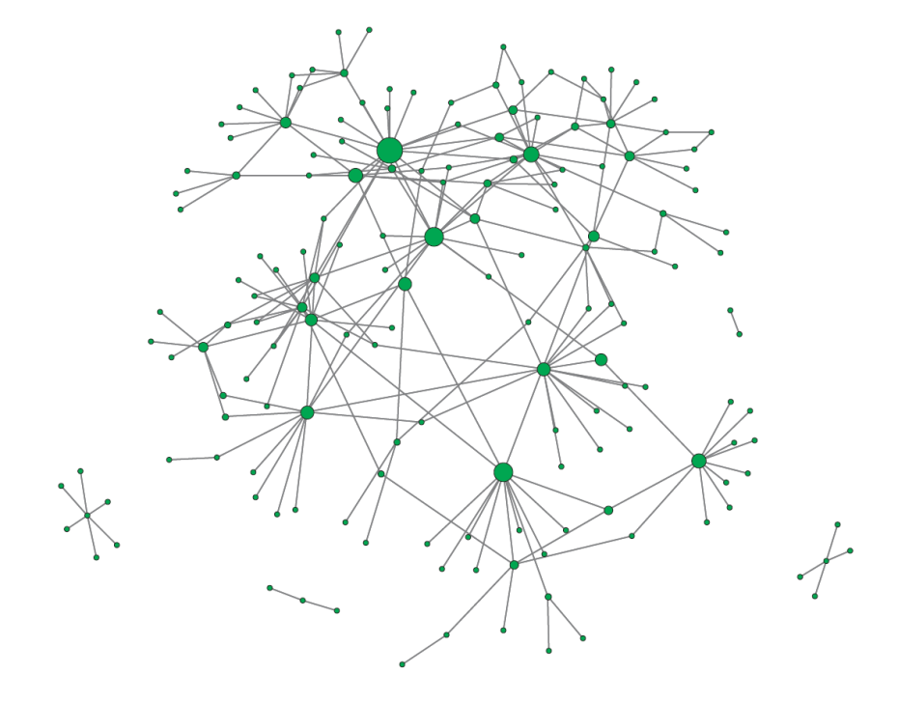
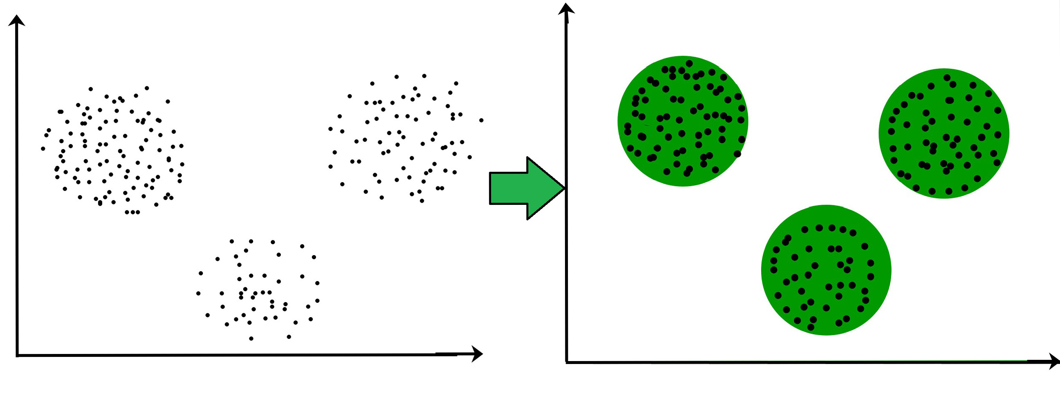
Unsupervised Classification
Typical example is clustering in social network analysis
The data are unlabeled, so you must use other methods to make groups.
For example, you may segment your customers by frequency of purchase, and then business leaders can use that to strategically target their customers.
Facebook can analyze your behaviors based on who your friends are.

Slide 17
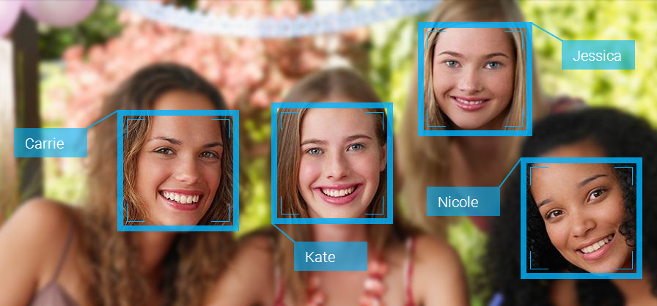
Semi-Supervised Learning
Combination of supervised and unsupervised learning
Some of the data is labeled, but most is unlabeled.
Facebook only needs one face to be labeled to identify someone in all pictures
Another example is a teacher provides examples in class, and then you go home and solve your homework based on what your learned.

Slide 18
Regression or Classification?
You are a weather forecaster and want to predict the high and low temperature tomorrow.
You work at a bank and a new customer walks in and takes out a mortgage loan. You want to know if they are going to default or not within the next five years.
You want to diagnose a patient with a disease.
You work at a Fortune 100 company and your company accountant wants to know the budget estimate for next year.

Slide 19
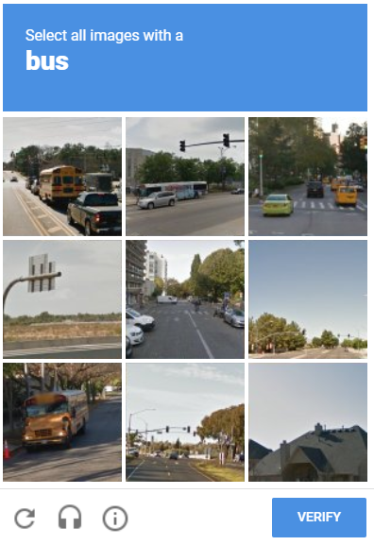
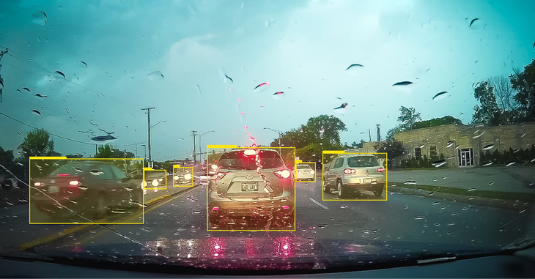
Image Recognition (Computer Vision)
Computers can “see” images by analyzing the pixels and edges.
Edges are large differences in pixel intensity.
Examples include license plate recognition, inventory condition and count, facial recognition.
Did you know you are labeling images when you use captcha?

Slide 20
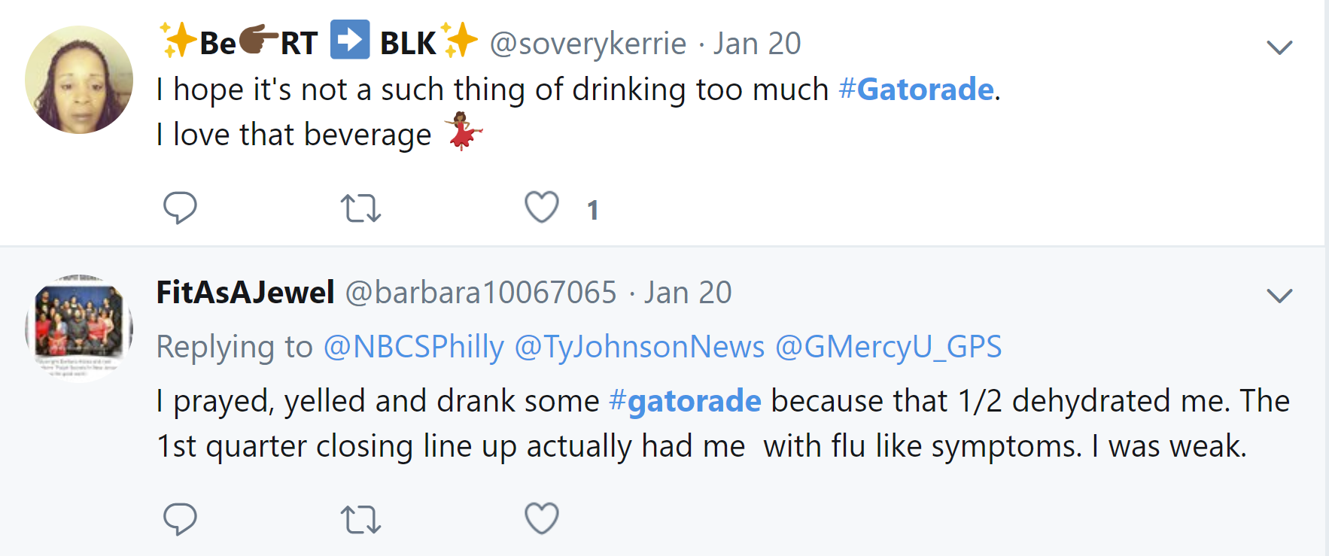
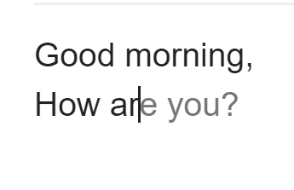
Natural Language Processing/Text Analysis
Sentiment Analysis from Text
Social media provides TONS of opinions and feedback about products and services that companies want to extract (too long to read all of them)
Review sources: Amazon, Yelp, Google…..
Predictive text for Gmail
Notes:
https://www.datacamp.com/community/tutorials/introduction-customer-segmentation-python

Slide 21
Data Science Roles
Data science roles require proficient knowledge in coding, methodologies, statistical analysis, and big data.
Data Scientist
Data Analyst
Data Engineer
Business Intelligence
Optimize & enable data for business & functional value capture & value creation
Analysis and interpretation of complex digital data to extract or discover knowledge and assist decision-making
Skills
Predictive modeling
Distributed computing
Machine learning/AI
Statistical analysis
Pattern recognition
Derive insights
Storytelling & visualization
Derive & interpret data to improve business function
Develop analysis and reporting capabilities, provide business recommendations
Skills
Data acquisition
Statistical analysis
Pattern recognition
Derive insights
Storytelling & visualization
Enable data access & utilization & enable value capture
Builds and supports the infrastructure or ‘data pipe’ and all associated SW engineering infrastructure tasks
Skills
Maintenance of data architecture
Hadoop ecosystem
Unstructured data
Data modeling
Data APIs
Database systems
Data ingest, ETI tools
Help the business make better decisions through data
Blend of business, analytics, and math skills to explore and solve challenges, bridging the data and business communities
Skills
Data interpretation
Decision making
Critical thinking
Data stewardship and management
Storytelling & visualization
Manager or Executive

Slide 22
Getting Started with Python

Slide 23
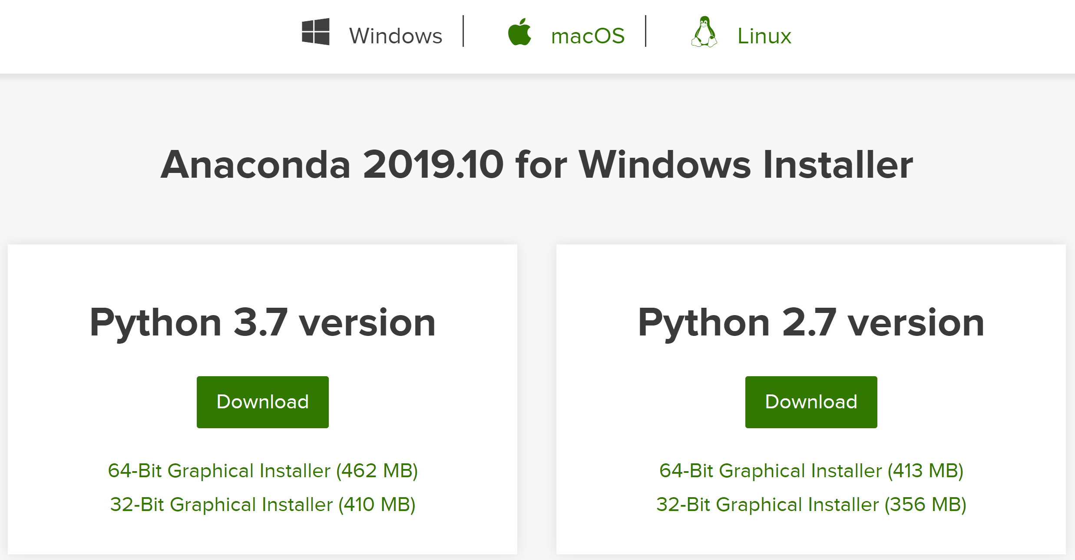
Downloading Anaconda
Download Anaconda at: https://www.anaconda.com/

Slide 24
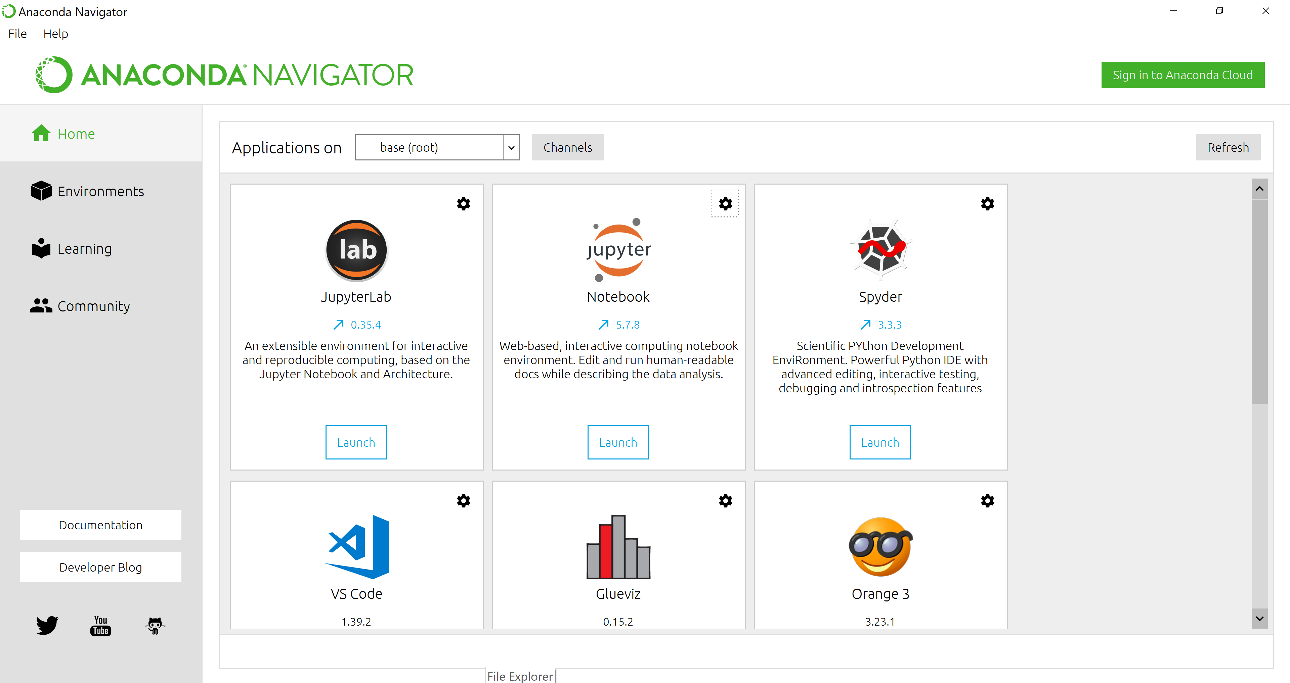
Opening Jupyter Notebooks
Launch Jupyter Notebook

Slide 25
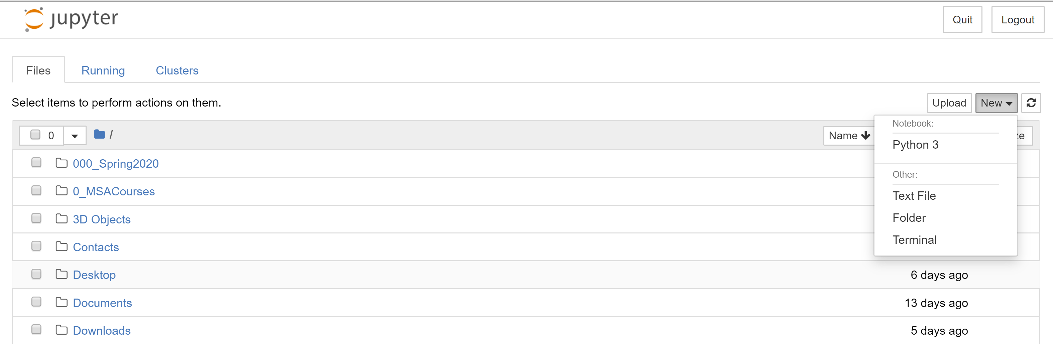
Opening New Jupyter Notebook
Create a new notebook

Slide 26
Upload New Jupyter Notebook
Upload notebook
Notebooks MUST be in .ipynb format

Slide 27
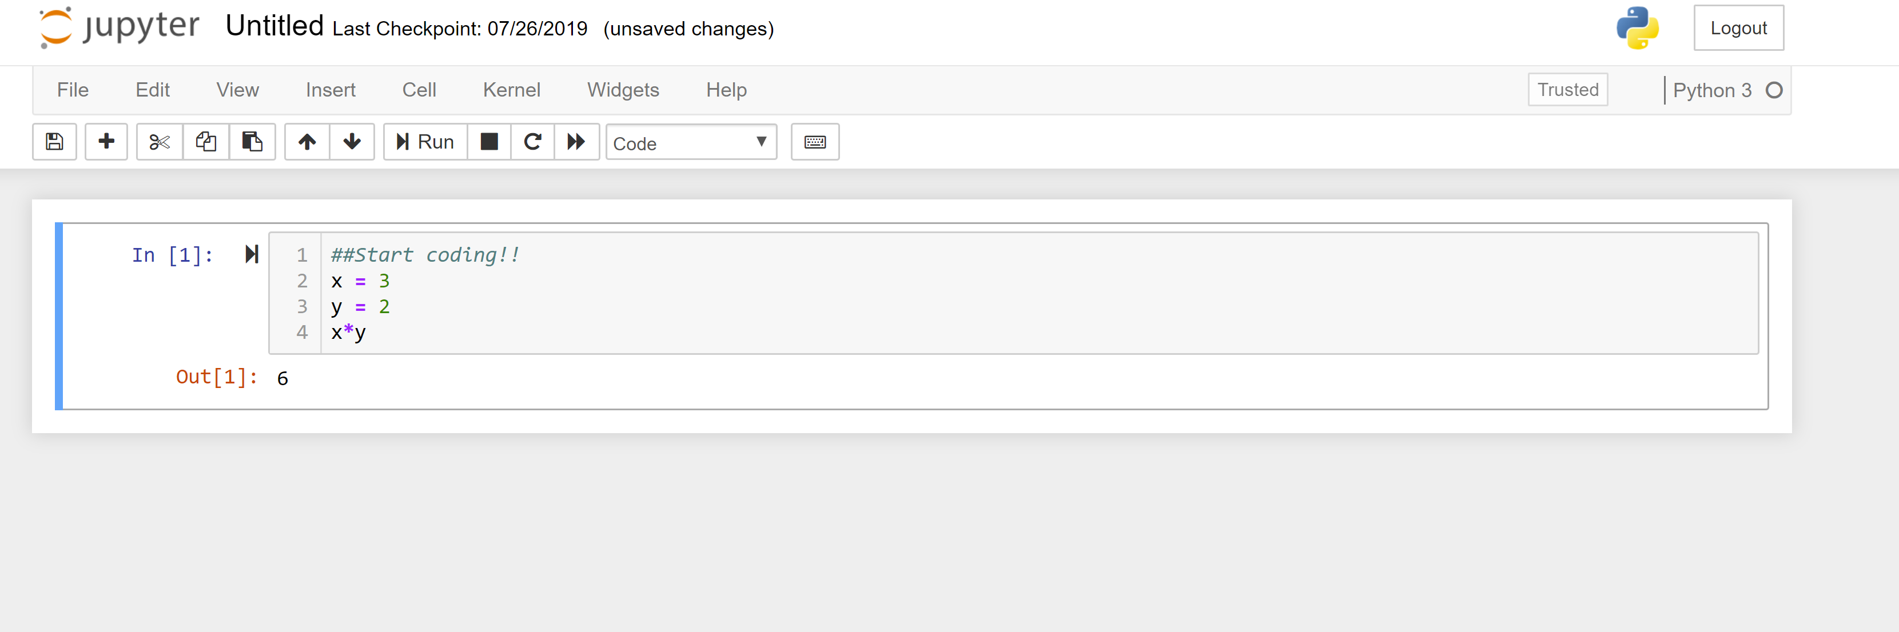
Start Coding!
Type code here
Code output

Slide 28
Troubleshooting
How to know how to write code:
Know what you are trying to find out
Google specific questions related to your problems

